Slide 1
Unit -2
Java Server Pages

Slide 2
Introduction to JSP
JSP technology is used to create web applications just like Servlet technology.
It can be considered an extension to servlet because it provides more functionality than servlet such as expression language, JSTL, etc.
A JSP page consists of HTML tags and JSP tags.
The JSP pages are easier to maintain than Servlet because we can separate design and development.
It provides additional features such as Expression Language, Custom Tags etc.

Slide 3
Need for JSP
Overcomes the limitations of Servlets by separating business logic and presentation.
Reduces complexity in web development.
Provides easier management for large-scale web applications.
Without JSP
out.println("<html>");
out.println("<h1>Welcome " + name + "</h1>");
out.println("</html>");
With JSP
<h1>Welcome ${name}</h1>

Slide 4
Servlet vs JSP
Servlet | JSP
Mainly Java code | Mainly HTML
HTML generated using Java | Java/JSP functionality embedded in HTML
Good for controller/business processing | Good for presentation
More out.println() | Less HTML-generation code
Difficult UI maintenance | Easier UI maintenance
.java | .jsp

Slide 5
Advantages of JSP over Servlets
Extension to Servlet
JSP technology is the extension to Servlet technology. We can use all the features of the Servlet in JSP. In addition to, we can use implicit objects, predefined tags, expression language and Custom tags in JSP, that makes JSP development easy
Easy to maintain
JSP can be easily managed because we can easily separate our business logic with presentation logic. In Servlet technology, we mix our business logic with the presentation logic
Execution of Servlets basically involves Six basic steps:

Slide 6
Advantages of JSP over Servlets
Fast Development: No need to recompile and redeploy
If JSP page is modified, we don't need to recompile and redeploy the project. The Servlet code needs to be updated and recompiled if we have to change the look and feel of the application.
Less code than Servlet
In JSP, we can use many tags such as action tags, JSTL, custom tags, etc. that reduces the code. Moreover, we can use EL, implicit objects, etc.
Execution of Servlets basically involves Six basic steps:

Slide 7
Life cycle of a JSP
Translation of JSP Page
Compilation of JSP Page
Classloading (the classloader loads class file)
Instantiation (Object of the Generated Servlet is created).
Initialization ( jspInit() method is invoked by the container).
Reqeust processing ( _jspService() method is invoked by the container).
Destroy ( jspDestroy() method is invoked by the container).
Execution of Servlets basically involves Six basic steps:

Slide 8
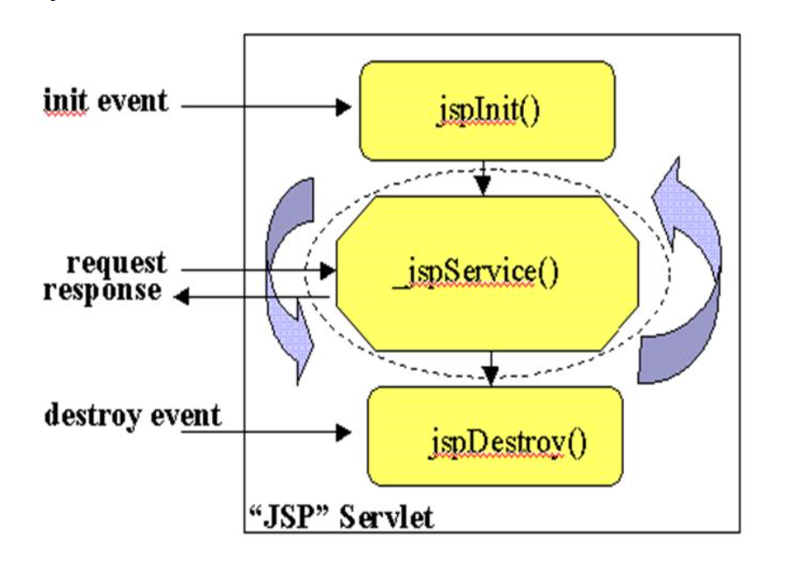
Life cycle of a JSP
Execution of Servlets basically involves Six basic steps:

Slide 9
JSP Scripting elements
In JSP, java code can be written inside the jsp page using the scriptlet tag.
The scripting elements provides the ability to insert java code inside the jsp.
Execution of Servlets basically involves Six basic steps:
Element | Syntax | Purpose
Scriptlet | <% %> | Java statements
Expression | <%= %> | Print value
Declaration | <%! %> | Declare fields/methods
Directive | <%@ %> | Give instructions to container
Comment | <%-- --%> | JSP comment

Slide 10
Scriptlet tag
A scriptlet tag is used to execute java source code in JSP. Syntax is as follows:
Example of JSP scriptlet tag
<html> <body>
<%
int a = 10;
int b = 20;
int sum = a + b;
%>
<p>Sum = <%= sum %></p>
</body> </html>
Execution of Servlets basically involves Six basic steps:

Slide 11
Expression tag
The code placed within JSP expression tag is written to the output stream of the response.
So you need not write out.print() to write data.
It is mainly used to print the values of variable or method.
Syntax of JSP expression tag
<%= statement %>
Example of JSP expression tag
In this example of jsp expression tag, we are simply displaying a welcome message.
<html>
<body>
<%= "welcome to jsp" %> </body> </html>
Execution of Servlets basically involves Six basic steps:

Slide 12
Declaration tag
The JSP declaration tag is used to declare fields and methods.
The code written inside the jsp declaration tag is placed outside the service() method of auto generated servlet.
Example:
<%!
int count = 0;
public int square(int n) {
return n * n;
}
%>
<%= square(5) %>
Execution of Servlets basically involves Six basic steps:

Slide 13
JSP Directives tag
Directives provide instructions to the JSP container during translation/processing of the JSP page.
JSP Directives type:
page
include
Taglib
Syntax:
<%@ directive attribute="value" %>
Execution of Servlets basically involves Six basic steps:

Slide 14
Page Directive tag
The page directive is used to define properties and configuration settings for the current JSP page.
<%@ page attribute="value" %> (Syntax)
<%@ page import="java.util.Date" %>
<%@ page contentType="text/html" %>
Execution of Servlets basically involves Six basic steps:
Attribute | Purpose
import | Imports Java classes/packages
contentType | Defines response content type
session | Enables/disables session
isErrorPage | Indicates that the JSP is an error page

Slide 15
Include Directive tag
The include directive is used to include the contents of another file into the current JSP.
<%@ include file="filename.jsp" %> (Syntax)
<%@ include file="header.jsp" %> (Example)
Execution of Servlets basically involves Six basic steps:

Slide 16
Taglib Directive tag
The taglib directive is used to tell the JSP container that the page will use a particular tag library.
<%@ taglib prefix="prefix" uri="URI" %> (Syntax)
<%@ taglib prefix="c" uri="jakarta.tags.core" %> (Example)
Execution of Servlets basically involves Six basic steps:
Part | Meaning
taglib | Directive type
prefix | Short name used to access the tags
uri | Identifies the tag library
c | Common prefix for JSTL core tags

Slide 17
Implicit Objects
There are 9 JSP implicit objects.
JSP provides predefined objects that we can use directly without creating them.
Execution of Servlets basically involves Six basic steps:

Slide 18
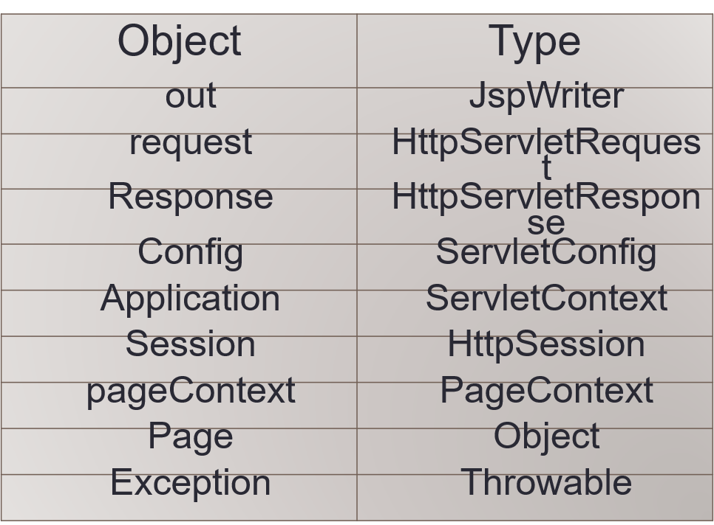
Implicit Objects
Execution of Servlets basically involves Six basic steps:

Slide 19
JSP out implicit object
For writing any data to the buffer, JSP provides an implicit object named out. It is the object of JspWriter. In case of servlet you need to write:
PrintWriter out=response.getWriter();
<html>
<body>
<% out.print("Today is:"+java.util.Calendar.getInstance().getTime());
%>
</body>
</html>
Execution of Servlets basically involves Six basic steps:

Slide 20
JSP request implicit object
The JSP request is an implicit object of type HttpServletRequest i.e. created for each jsp request by the web container.
It can be used to get request information such as parameter, header information, remote address, server name, server port, content type, character encoding etc.
It can also be used to set, get and remove attributes from the jsp request scope.
<%= request.getParameter("name") %>
Execution of Servlets basically involves Six basic steps:

Slide 21
JSP response implicit object
In JSP, response is an implicit object of type HttpServletResponse.
The instance of HttpServletResponse is created by the web container for each jsp request.
It can be used to add or manipulate response such as redirecting responses to another resource, send error etc.
Example:
<%
response.sendRedirect("home.jsp");
%>
Execution of Servlets basically involves Six basic steps:

Slide 22
JSP config implicit object
In JSP, config is an implicit object of type ServletConfig.
This object can be used to get initialization parameter for a particular JSP page.
The config object is created by the web container for each jsp page.
Execution of Servlets basically involves Six basic steps:

Slide 23
JSP application implicit object
In JSP, application is an implicit object of type ServletContext.
The instance of ServletContext is created only once by the web container when application or project is deployed on the server.
This object can be used to get initialization parameter from configuration file (web.xml).
It can also be used to get, set or remove attribute from the application scope.
Execution of Servlets basically involves Six basic steps:

Slide 24
session implicit object
In JSP, session is an implicit object of type HttpSession.
The Java developer can use this object to set,get or remove attribute or to get session information.
Example:
<%
session.setAttribute("username", "Gaurav");
%>
Execution of Servlets basically involves Six basic steps:

Slide 25
pageContext implicit object
In JSP, pageContext is an implicit object of type PageContext class.The pageContext object can be used to set,get or remove attribute from one of the following scopes:
Execution of Servlets basically involves Six basic steps:
Scope | Lifetime
Page | Current JSP
Request | Current request
Session | User session
Application | Entire application

Slide 26
page implicit object:
In JSP, page is an implicit object of type Object class.
This object is assigned to the reference of auto generated servlet class. It is written as:
Object page=this;
For using this object it must be cast to Servlet type.
For example:
<% (HttpServlet)page.log("message"); %>
Execution of Servlets basically involves Six basic steps:

Slide 27
exception implicit object
In JSP, exception is an implicit object of type java.lang.Throwable class.
This object can be used to print the exception.
But it can only be used in error pages.
error.jsp
<%@ page isErrorPage="true" %>
<html>
<body>
Execution of Servlets basically involves Six basic steps:

Slide 28
JSP ACTION TAGS
JSP action tags perform an action during request processing.
Example:
<jsp:include>
<jsp:forward>
<jsp:param>
<jsp:useBean>
<jsp:setProperty>
<jsp:getProperty>
Execution of Servlets basically involves Six basic steps:

Slide 29
JSP ACTION TAGS
<jsp:forward>
Transfers the request to another resource on the server.
Example:
<jsp:forward page="welcome.jsp">
<jsp:param name="name" value="Gaurav"/>
</jsp:forward>
Execution of Servlets basically involves Six basic steps:

Slide 30
Introduction to java beans
Execution of Servlets basically involves Six basic steps:
Java Bean
A Java Bean is a java class that should follow following conventions:
It should have a no-arg constructor.
It should be Serializable.
It should provide methods to set and get the values of the properties, known as getter and setter methods.

Slide 31
Why use Java Bean?
According to Java white paper, it is a reusable software component.
A bean encapsulates many objects into one object, so we can access this object from multiple places.
Moreover, it provides the easy maintenance.
Key Features:
Public default constructor.
Implements Serializable.
Getter and setter methods for properties.
Purpose: Simplifies data management and interaction in server-side applications.
Execution of Servlets basically involves Six basic steps:

Slide 32
Simple Example of Java Bean Class
import java.io.Serializable;
public class UserBean implements Serializable {
private String name;
private int age;
public UserBean() {} // Default Constructor
public String getName() { return name; }
public void setName(String name) { this.name = name; }
public int getAge() { return age; }
public void setAge(int age) { this.age = age; }
}
Execution of Servlets basically involves Six basic steps:

Slide 33
Instantiating a JavaBean in JSP:
<jsp:useBean id="user" class="UserBean" scope="session" />
Execution of Servlets basically involves Six basic steps:
Scopes:
page: Current JSP only.
request: Current request.
session: Entire session.
application: Entire application.

Slide 34
jsp:useBean action tag
The jsp:useBean action tag is used to locate or instantiate a bean class.
If bean object of the Bean class is already created, it doesn't create the bean depending on the scope.
But if object of bean is not created, it instantiates the bean.
Syntax of jsp:useBean action tag:
<jsp:useBean id= "instanceName" scope= "page | request | session | application"

Slide 35
Writing Properties of JavaBeans
Setting Properties with <jsp:setProperty>:
<jsp:setProperty name="beanName" property="propertyName" value="value" />
Example:
<jsp:setProperty name="user" property="name" value="John Doe" />
<jsp:setProperty name="user" property="age" value="30" />
Automatic Mapping:
<jsp:setProperty name="user" property="*" />
Maps all matching request parameters to JavaBean properties.

Slide 36
Reading Properties of JavaBeans
getProperty :
<jsp:getProperty name="beanName" property="propertyName" />
<p>Name: <jsp:getProperty name="user" property="name" /></p>
<p>Age: <jsp:getProperty name="user" property="age" /></p>

Slide 37
Attributes and Usage of jsp:useBean action tag
id: is used to identify the bean in the specified scope.
scope: represents the scope of the bean. It may be page, request, session or application. The default scope is page.
page: specifies that you can use this bean within the JSP page. The default scope is page.
request: specifies that you can use this bean from any JSP page that processes the same request. It has wider scope than page.
session: specifies that you can use this bean from any JSP page in the same session whether processes the same request or not. It has wider scope than request.
application: specifies that you can use this bean from any JSP page in the same application. It has wider scope than session.

Slide 38
7. class: instantiates the specified bean class (i.e. creates an object of the bean class) but it must have no-arg or no constructor and must not be abstract.

Slide 39
Syntax of jsp:setProperty action tag
<jsp:setProperty name="instanceOfBean" property= "*" |
property="propertyName" param="parameterName" |
property="propertyName" value="{ string | <%= expression %>}"
/>
Example of jsp:setProperty action tag if you have to set all the values of incoming request in the bean
<jsp:setProperty name="bean" property="*" />

Slide 40
Expression Language (EL) in JSP
The Expression Language (EL) simplifies the accessibility of data stored in the Java Bean component, and other objects like request, session, application etc.
Syntax for Expression Language
${ expression }
Traditional JSP
<%= user.getName() %>
Using EL
${user.name}
EL provides a simpler way to access data stored in Beans and different JSP scopes.

Slide 41
EL vs Traditional JSP
Without EL
<%
String name = (String) session.getAttribute("username");
%>
Welcome <%= name %>
Using EL
Welcome ${sessionScope.username}

Slide 42
Accessing Variables Using EL
Example 1:
request.setAttribute("name", "Gaurav");
${name}
Example 2:
request.setAttribute("marks", 85);
Marks: ${marks}

Slide 43
Invoking Expression Language
EL can be used directly in JSP pages to access data and objects.
<jsp:useBean id="user" class="UserBean" scope="session" />
Name: ${user.name}
Age: ${user.age}
EL can access attributes from four scopes:
page: Current JSP only.
request: Current request.
session: Entire session.
application: Entire application

Slide 44
EL Implicit Objects
EL has its own implicit objects, which are different from the nine JSP implicit objects.
Important EL implicit objects include:
EL Object | Purpose
pageScope | Access page-scope attributes
requestScope | Access request-scope attributes
sessionScope | Access session-scope attributes
applicationScope | Access application-scope attributes
param | Access request parameters
paramValues | Access multiple values of a parameter
cookie | Access cookies

Slide 45
param Object
Html Page
<form action="welcome.jsp">
Name:
<input type="text" name="username">
<input type="submit">
</form>
JSP Page
Welcome ${param.username}

Slide 46
paramValues Object
Html Page
<input type="checkbox" name="skill" value="Java">
<input type="checkbox" name="skill" value="JSP">
<input type="checkbox" name="skill" value="Spring">
JSP Page
${paramValues.skill}

Slide 47
Preventing EL Evaluation
By Default: EL expressions are evaluated in JSP 2.0.
To Disable EL Evaluation:
<%@ page isELIgnored="true" %>
Disable EL in the deployment descriptor (web.xml):
<jsp-config>
<el-ignored>true</el-ignored>
</jsp-config>
\${user.name}
Escape EL expressions using \ :

Slide 48
Accessing Scoped Variables
EL allows you to access variables from any scope (page, request, session, application).
Precedence of Scopes:
pageScope
requestScope
sessionScope
applicationScope
Syntax:
${scopeName.variableName}
Example:
${pageScope.message}

Slide 49
JSTL -JSP - Standard Tag Library
JSTL is a collection of predefined JSP tags that provides common functionality without writing Java code directly inside JSP..
JSTL helps remove Java code from JSP and makes the presentation layer cleaner and easier to maintain.
It also provides a framework for integrating existing custom tags with JSTL tags.

Slide 50
Why JSTL?
Traditional JSP:
<%
if (marks >= 40) {
out.println("Pass");
}
%>
With JSTL:
<c:if test="${marks >= 40}">
Pass
</c:if>

Slide 51
JSTL Tag Libraries
The JSTL tags can be classified, according to their functions
Library | Prefix | Purpose
Core | c | Conditions, loops, variables
Formatting | fmt | Formatting numbers, dates, messages
SQL | sql | Database operations
XML | x | XML processing
Functions | fn | String/collection functions

Slide 52
How to Use JSTL?
Before using JSTL tags, the appropriate JSTL library must be available to the application.
First import:
<%@ taglib prefix="c" uri="jakarta.tags.core" %>
Then, we can use:
<c:if>
<c:forEach>
<c:choose>

Slide 53
JSTL Core Tags
The core group of tags are the most frequently used JSTL tags.
Tag | Purpose
<c:out> | Display output
<c:set> | Set a variable
<c:remove> | Remove a variable
<c:if> | Conditional processing
<c:choose> | Multiple conditions
<c:when> | Individual condition
<c:otherwise> | Default condition
<c:forEach> | Iteration

Slide 54
JSTL Core Tags
Example 1:
<c:set var="name" value="Gaurav" />
${name}
Output:
Gaurav
Example 2:
<c:set var="username"
value="Gaurav"
scope="session" />
${sessionScope.username}
Output: Gaurav

Slide 55
JSTL Core Tags
Example 3:
<c:set var="message" value="Hello" />
${message}
<c:remove var="message" />
${message}
Example 4:
<c:if test="${marks >= 40}">
Pass
</c:if>

Slide 56
JSTL Core Tags
Example 5:
<c:choose>
<c:when test="${marks >= 80}">
Grade A
</c:when>
<c:when test="${marks >= 60}">
Grade B
</c:when>
<c:otherwise>
Fail
</c:otherwise>
</c:choose>

Slide 57
JSTL Core Tags
Example 6:
<c:forEach var="i" begin="1" end="5">
${i}<br>
</c:forEach>
Example 7:
<c:forEach var="student" items="${students}">
${student}<br>
</c:forEach>

Slide 58
JSTL Core Tags
Example 8:
<c:url var="loginUrl" value="login.jsp" />
Example 9:
<c:url var="url" value="student.jsp">
<c:param name="id" value="101" />
</c:url>
Example 10:
<c:redirect url="login.jsp" />

Slide 59
JSTL Formatting Library
Syntax:
<%@ taglib prefix="fmt" uri="..." %>
Used for:
Number formatting
Date/time formatting
Internationalization
Localization
Important tags:
<fmt:formatNumber>
<fmt:formatDate>
<fmt:parseNumber>
<fmt:parseDate>

Slide 60
JSTL Formatting Library
Example 1:
<fmt:formatNumber
value="${price}"
type="currency" />
Example 2:
<fmt:formatNumber
value="${percentage}"
type="percent" />
Example 3:
<fmt:formatDate
value="${today}"
pattern="dd-MM-yyyy" />

Slide 61
JSTL Formatting Library
Example 1:
<fmt:formatNumber
value="${price}"
type="currency" />
Example 2:
<fmt:formatNumber
value="${percentage}"
type="percent" />
Example 3:
<fmt:formatDate
value="${today}"
pattern="dd-MM-yyyy" />

Slide 62
JSTL Functions
Functions are mainly used for String and collection operations.
Syntax:
<%@ taglib prefix="fn" uri="..." %>
Important Tags:
fn:length()
fn:toUpperCase()
fn:toLowerCase()
fn:contains()
fn:startsWith()
fn:endsWith()
fn:substring()
fn:trim()

Slide 63
JSTL Functions
Examples:
${fn:length(name)}
${fn:toUpperCase(name)}
${fn:toLowerCase(name)}
${fn:contains(name, "Gaurav")}

Slide 64
JSTL SQL Tags
JSTL provides SQL tags for performing basic database operations directly from a JSP page.
These tags can be used to:
Establish a database connection
Execute SELECT queries
Execute INSERT, UPDATE, and DELETE statements
Pass parameters safely to SQL statements
SQL tags use the prefix sql.

Slide 65
JSTL SQL Tags
Syntax:
<%@ taglib prefix="sql" uri="jakarta.tags.sql" %>
Tag | Purpose
<sql:setDataSource> | Creates/configures a DataSource
<sql:query> | Executes SELECT queries
<sql:update> | Executes INSERT/UPDATE/DELETE
<sql:param> | Supplies parameters to SQL
<sql:dateParam> | Supplies date/time parameters
<sql:transaction> | Groups operations into a transaction

Slide 66
JSTL SQL Tags
JSTL SQL tags are useful for learning/demo purposes, but in a properly designed application we generally prefer Servlet → DAO → Database rather than putting SQL directly into JSP.
Example:
<sql:setDataSource
var="db"
driver="com.mysql.cj.jdbc.Driver"
url="jdbc:mysql://localhost:3306/college"
user="root"
password="root" />

Slide 67
JSTL SQL Tags
After creating connection:
<sql:query var="result" dataSource="${db}">
SELECT * FROM student
</sql:query>
After executing query:
<c:forEach var="row" items="${result.rows}">
${row.id}
${row.name}
${row.email}
<br>
</c:forEach>

Slide 68
JSTL SQL Tags
For Inserting Data:
<sql:update dataSource="${db}">
INSERT INTO student(name, email)
VALUES('Rahul', 'rahul@gmail.com')
</sql:update>
For Updating Data:
<sql:update dataSource="${db}">
UPDATE student
SET email='new@gmail.com'
WHERE id=101
</sql:update>

Slide 69
JSTL SQL Tags
For Parameterized Query:
<sql:update dataSource="${db}">
UPDATE student
SET email = ?
WHERE id = ?
<sql:param value="${email}" />
<sql:param value="${id}" />
</sql:update>

Slide 70
Introduction to Custom Tags
Custom tags are user-defined JSP tags that encapsulate reusable functionality.
They allow you to move Java code out of JSP pages and into reusable components.
Custom tags are implemented as Java classes (tag handlers).
They are declared in a Tag Library Descriptor (TLD) file.
Used in JSP pages via the <%@ taglib %> directive.

Slide 71
Introduction to Custom Tags
Instead of Writing:
<%
Date d = new Date();
out.print(d);
%>
We can create:
<ct:currentDateTime />

Slide 72
Steps to Create Custom Tags
1. Create a Tag Handler Class:
A Java class that implements the tag's functionality.
Extends TagSupport or implements Tag, IterationTag, or BodyTag interfaces.
2. Create a Tag Library Descriptor (TLD) File:
An XML file that maps the tag name to the tag handler class.
3. Use the Custom Tag in a JSP Page:
Declare the tag library using <%@ taglib %>.
Use the custom tag in the JSP page.

Slide 73
Example - Creating a Simple Custom Tag
Step 1: Create the Tag Handler Class
import java.io.IOException;
import java.text.SimpleDateFormat;
import java.util.Date;
import javax.servlet.jsp.JspException;
import javax.servlet.jsp.JspWriter;
import javax.servlet.jsp.tagext.TagSupport;
public class CurrentDateTimeTag extends TagSupport {

Slide 74
Example - Creating a Simple Custom Tag
public int doStartTag() throws JspException {
try {
String dateTime = new SimpleDateFormat("yyyy-MM-dd HH:mm:ss").format(new Date());
JspWriter out = pageContext.getOut();
out.print(dateTime);
} catch (IOException e) {
throw new JspException("Error: " + e.getMessage());
}
return SKIP_BODY; // Skip the tag body
}}

Slide 75
Example - Creating a Simple Custom Tag
Step 2: Create the TLD File
<tag>
<name>currentDateTime</name>
<tag-class>com.example.tags.CurrentDateTimeTag</tag-class>
<body-content>empty</body-content>
</tag>
</taglib>

Slide 76
Example - Creating a Simple Custom Tag
Step 3: Use the Custom Tag in a JSP Page
<%@ page language="java" contentType="text/html; charset=UTF-8" %>
<%@ taglib uri="/WEB_INF/mytags" prefix="ct" %>
<html><head>
<title>Custom Tag Example</title>
</head>
<body>
<h1>Current Date and Time</h1>
<p><ct:currentDateTime /></p>
</body></html>

